Slide 1
Two-way ANOVA——Amputee data

Slide 2
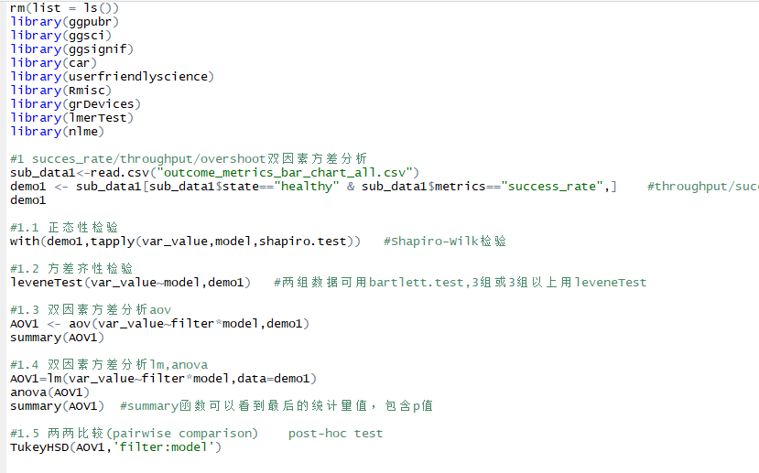
var_value~filter*model

Slide 3
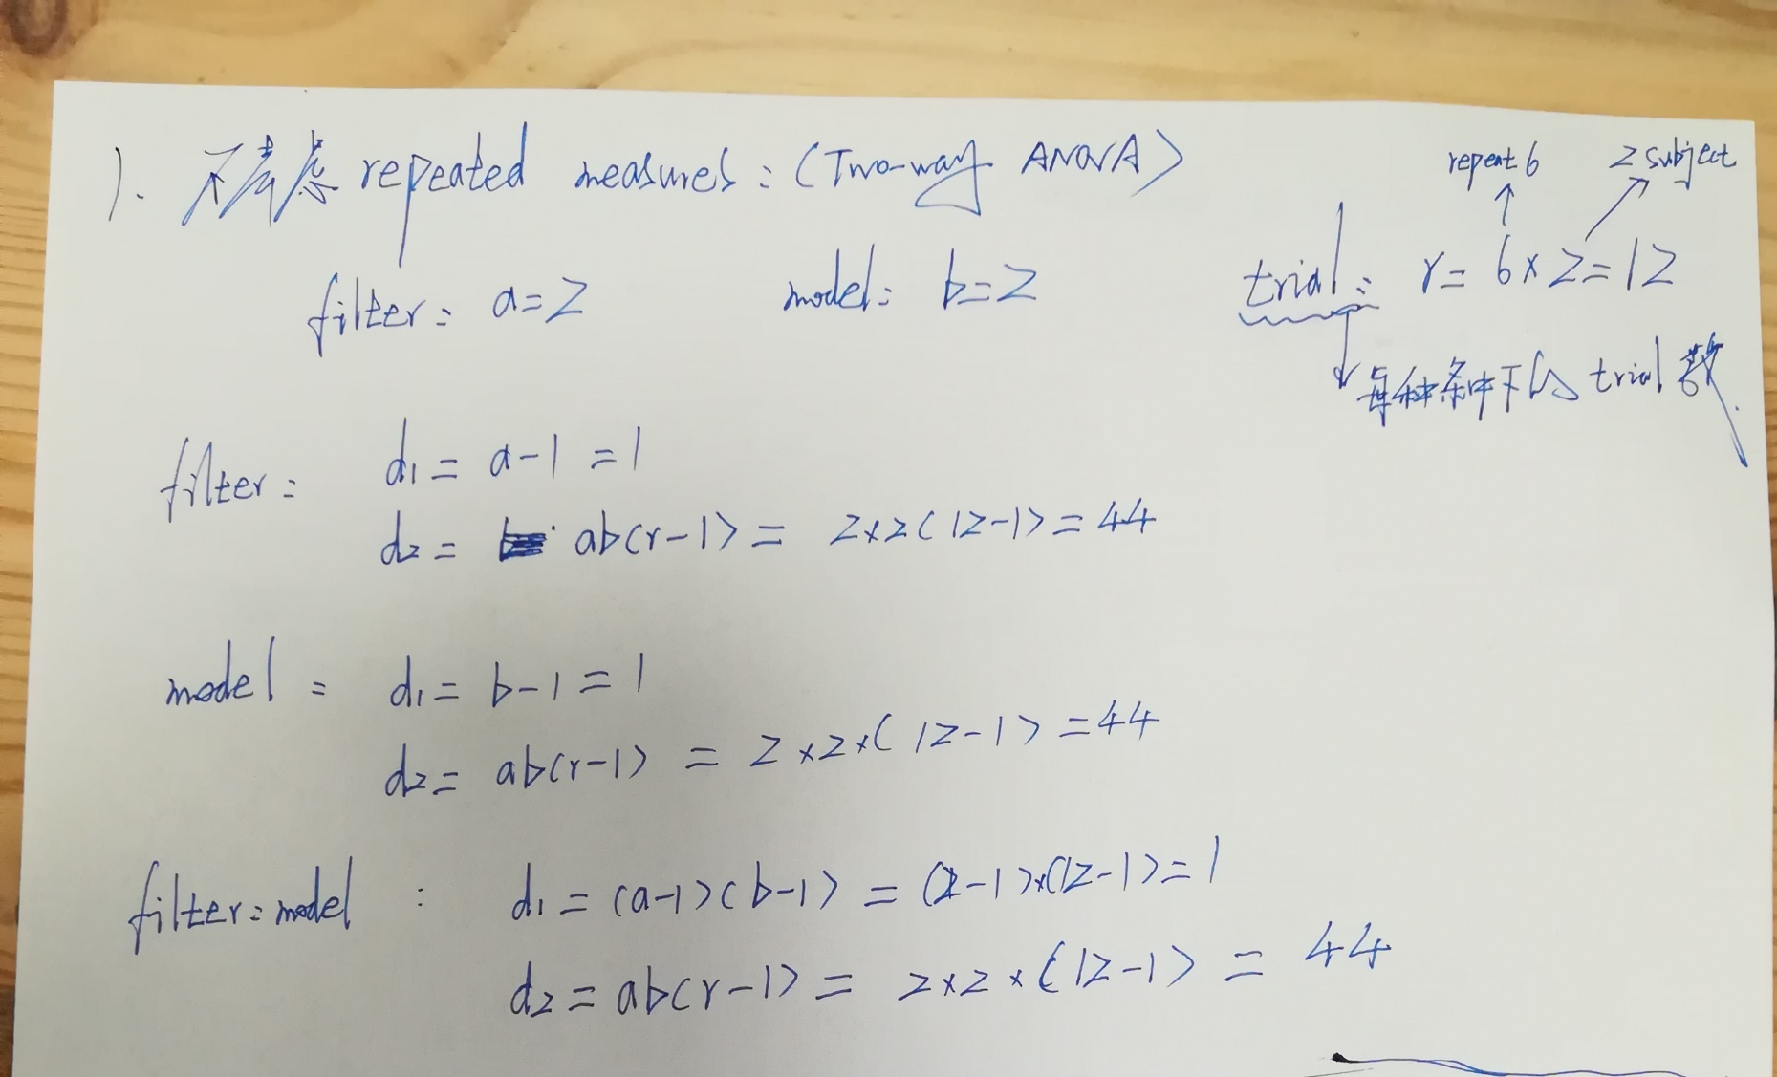
自由度计算：

Slide 4
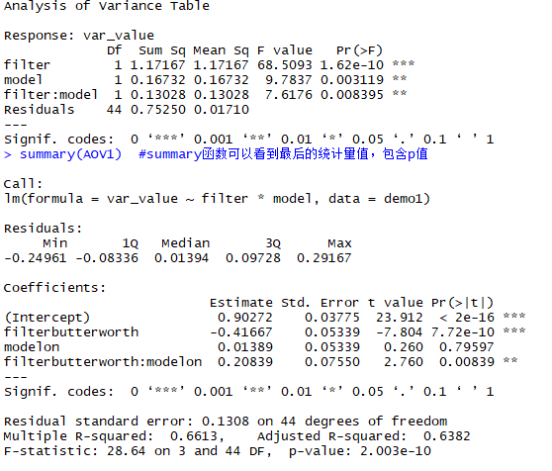
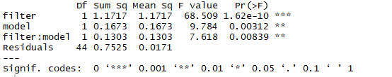
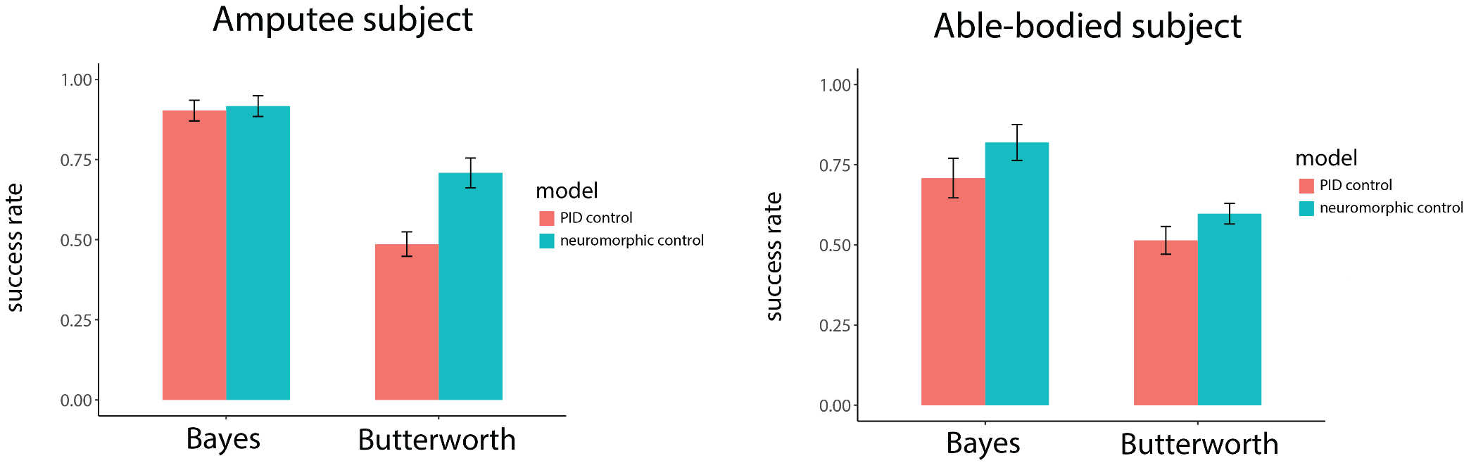
Success rate——Amputee
利用lm, anova
利用aov
filter—F(1,44)=68.5093, P<0.001
filter—F(1,44)=68.509, P<0.001
model—F(1,44)=9.7837, P<0.01
model—F(1,44)=9.784, P<0.01
filter: model —F(1,44)=7.6176, P<0.01
filter: model —F(1,44)=7.618, P<0.01

Slide 5
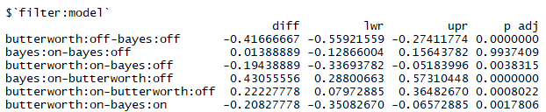
SR — post hoc test

Slide 6
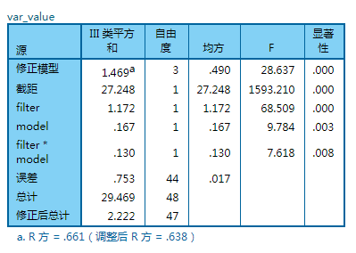
Success rate——利用SPSS
filter—F(1,44)=68.509, P<0.001
model—F(1,44)=9.784, P<0.01
filter: model —F(1,44)=7.618, P<0.01

Slide 7
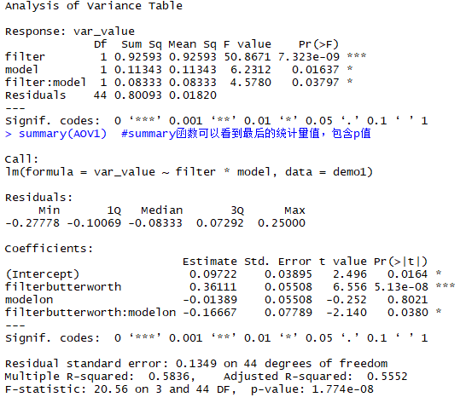
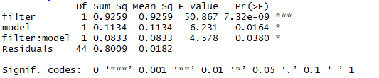
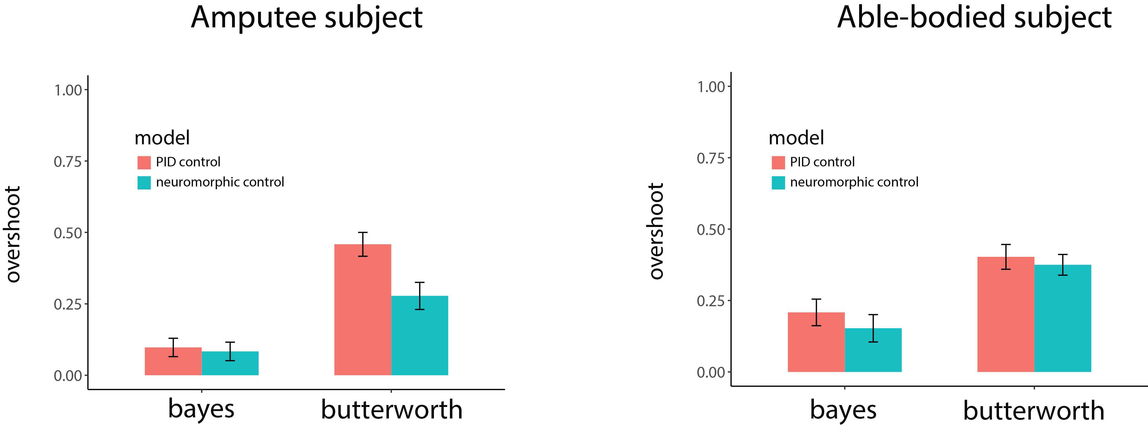
Overshoot ——Amputee
利用aov
filter: F(1,44)=50.8671, P<0.001
filter—F(1,44)=50.867, P<0.001
利用lm, anova
model: F(1,44)=6.2312, P<0.05
model—F(1,44)=6.231, P<0.05
filter: model —F(1,44)=4.5780, P<0.05
filter: model —F(1,44)=4.578, P<0.05
Bayes Butterworth

Slide 8
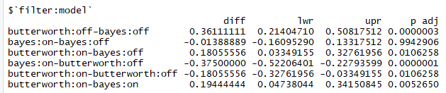
OS — post hoc test
Bayes Butterworth

Slide 9
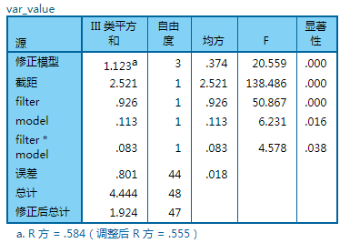
overshoot——利用SPSS
filter: F(1,44)=50.867, P<0.001
model: F(1,44)=6.231, P<0.05
filter: model —F(1,44)=4.578, P<0.05

Slide 10
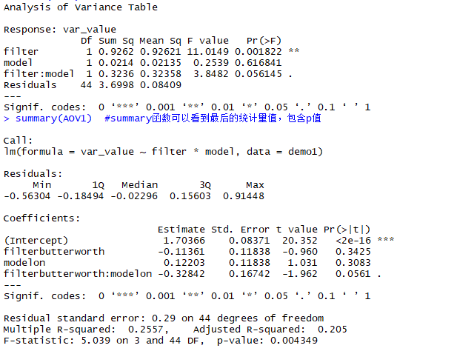
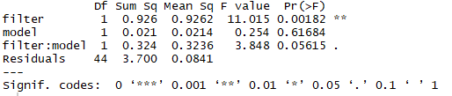
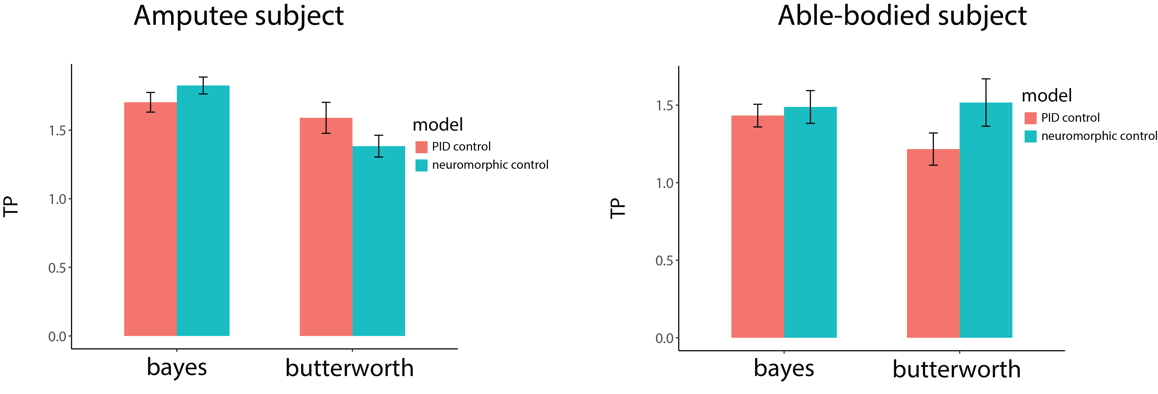
Throughput ——Amputee
利用aov
filter—F(1,44)=11.0149, P<0.01
filter—F(1,44)=11.015, P<0.01
利用lm, anova
mode—F(1,44)=0.2539, P=0.616841
mode—F(1,44)=0.254, P=0.61684
filter: model —F(1,44)=3.8482, P=0.056145
filter: model —F(1,44)=3.848, P=0.05615
Bayes Butterworth

Slide 11
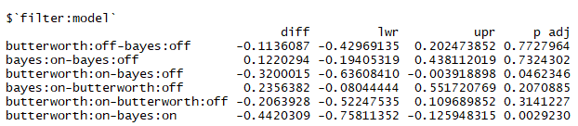
TP — post hoc test
Bayes Butterworth

Slide 12
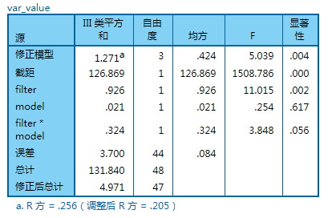
TP——利用SPSS
filter— F(1,44)=11.015, P<0.01
model—F(1,44)=0.254, P=0.617
filter: model —F(1,44)=3.848, P=0.056

Slide 13
ANOVA——Able-bodied data
R与SPSS分析结果一致，具体结果见下文：

Slide 14
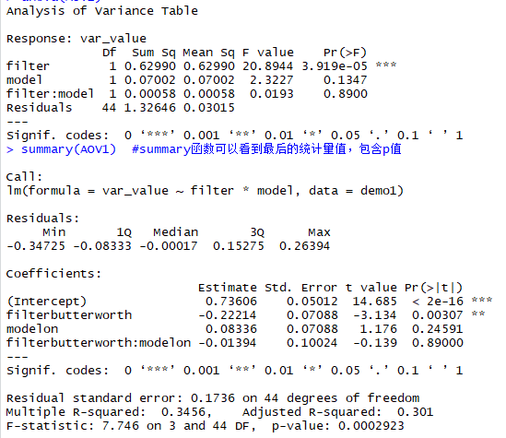
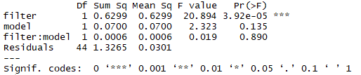
Success rate——able-bodied subject
利用aov
filter—F(1,44)=20.8944, P<0.001
利用lm, anova
filter— F(1,44)=20.894, P<0.001
model—F(1,44)=2.3227, P=0.1347
model—F(1,44)=2.323, P=0.135
filter: model —F(1,44)=0.0193, P=0.8900
filter: model —F(1,44)=0.019, P=0.890

Slide 15
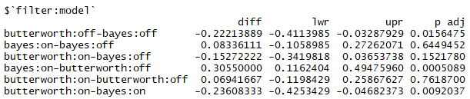
SR — post hoc test

Slide 16
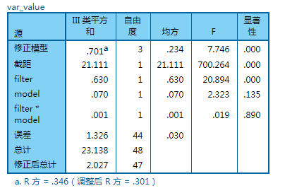
Success rate——利用SPSS
filter—F(1,44)=20.894, P<0.001
model—F(1,44)=2.323, P=0.135
filter: model —F(1,44)=0.019, P=0.890

Slide 17
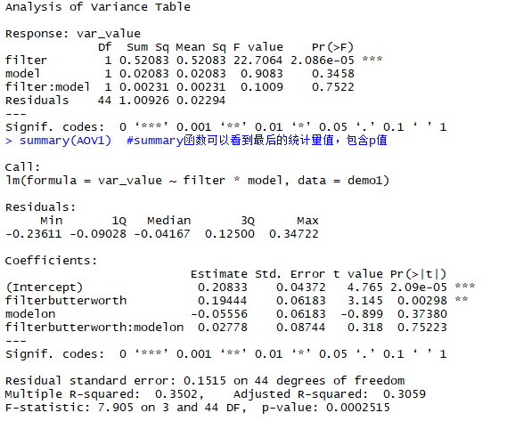
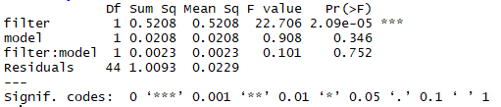
Overshoot ——able-bodied subject
filter—F(1,44)=22.706, P<0.001
利用aov
利用lm, anova
filter—F(1,44)=22.706, P<0.001
model—F(1,44)=0.9083, P=0.3458
model—F(1,44)=0.908, P=0.344
filter: model —F(1,44)=0.1009, P=0.7522
filter: model —F(1,44)=0.101, P=0.752
Bayes Butterworth

Slide 18
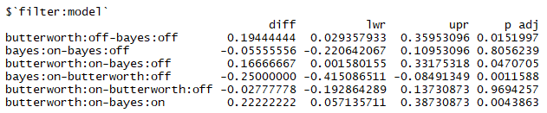
OS — post hoc test
Bayes Butterworth

Slide 19
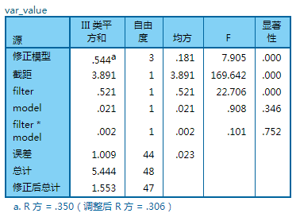
overshoot——利用SPSS
filter: F(1,44)=22.706, P<0.001
model: F(1,44)=0.908, P=0.344
filter: model —F(1,44)=0.101, P=0.752

Slide 20

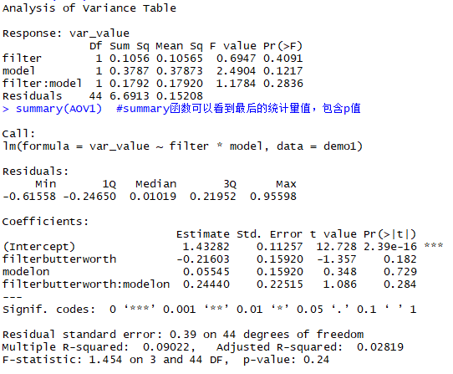
Throughput ——able-bodied subject
利用aov
filter: F(1,44)=0.6947, P=0.4091
filter: F(1,44)=0.695, P=0.409
利用lm, anova
model: F(1,44)=2.4904, P=0.1217
model: F(1,44)=2.490, P=0.122
filter: model —F(1,44)=1.1784, P=0.2836
filter: model —F(1,44)=1.178, P=0.284
Bayes Butterworth

Slide 21
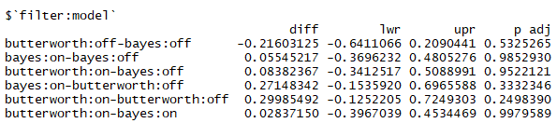
TP — post hoc test
Bayes Butterworth

Slide 22
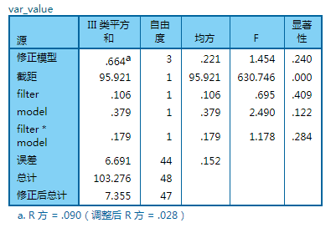
TP——利用SPSS
filter: F(1,44)=0.695, P=0.409
model: F(1,44)=2.490, P=0.122
filter: model —F(1,44)=1.178, P=0.284

